Slide 1
Fragments
INFO 5126: Mobile Development Advanced

Slide 2
Two Ways to Add a Fragment to an Activity
Static: be part of the UI of an Activity, the Fragment remains on the screen during the entire lifecycle of the Activity.
Dynamic: an activity can adds or removes the Fragment dynamically while the Activity is running.

Slide 3
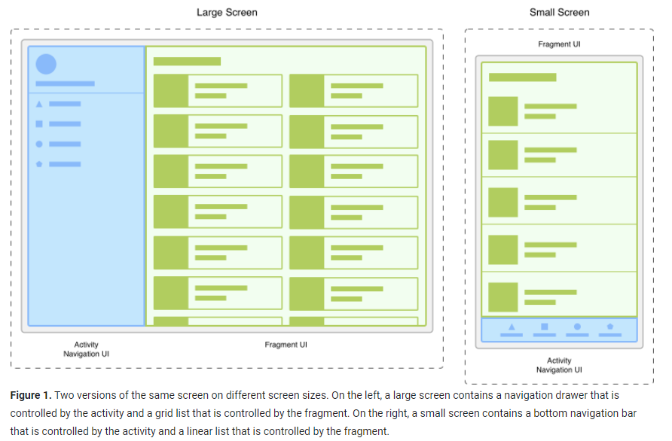
How Fragments are used
Provide Modularity and Reusability into your activities UI

Slide 4
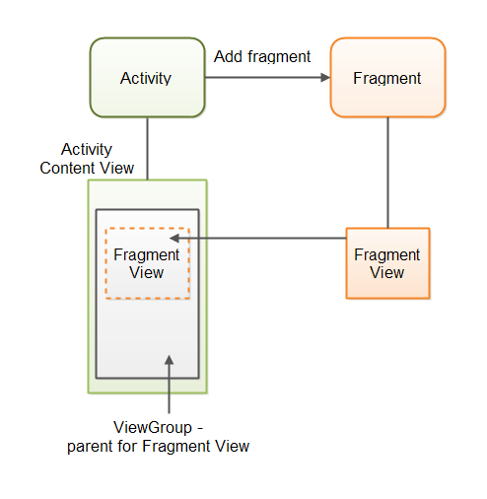
Android fragment and Activity

Slide 5
Fragments
A fragment represents a reusable portion of your app’s UI
Has it’s own layout
Has it’s own lifecycle, but it is always connected to the life cycle of the activity which uses the fragment
Receives its’ own input events
You may add or remove the fragment dynamically when the activity is running
Cannot live on their own, they must be hosted by an activity or another fragment

Slide 6
Benefits of using fragments
Reuse a Fragment in more than one Activity
Add or remove dynamically as needed
Integrate a mini-UI within an Activity
Retain data instances after a configuration change
Represent sections of a layout for different screen sizes

Slide 7
More Fragment lifecycle callbacks
onAttach(): Called when Fragment is first attached to Activity
onPause(): Called when Activity is paused
onResume(): Called by Activity to resume a visible Fragment
onActivityCreated(): Called when Activity onCreate() method has returned
onDestroyView(): Called when View previously created by onCreateView() is detached from Fragment

Slide 8
Use onDestroyView
Use onDestroyView() to perform action after Fragment is no longer visible
Called after onStop() and before onDestroy()
View that was created in onCreateView() is destroyed
A new View is created next time Fragment needs to be displayed

Slide 9
Creating a fragment
Fragments

Slide 10
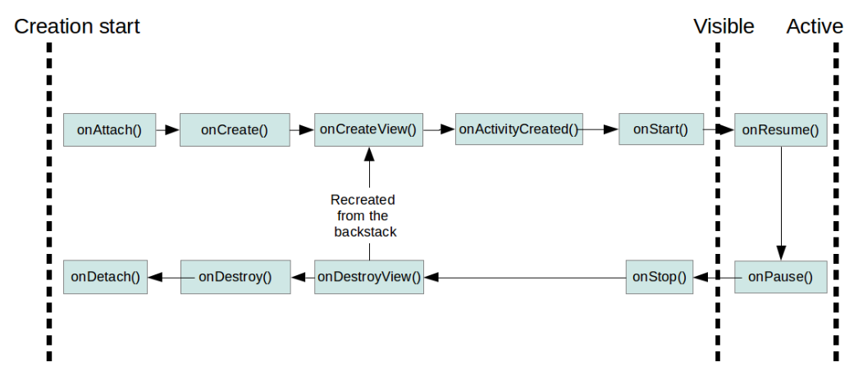
Fragment Life Cycle

Slide 11
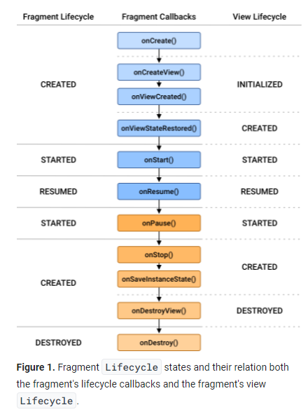
Fragment Lifecycle

Slide 12
Steps to using a fragment
Create a subclass of Fragment
Create a layout for the Fragment
Use FragmentContainerView in the layout
Add Fragment to a host Activity
Statically in layout
Dynamically using fragment transactions

Slide 13
Creating new Fragments
Like an Activity, each fragment has
A xml file defines the layout
A corresponding kotlin/java file
File-New-Fragment-Blank Fragment

Slide 14
Add your fragment to your activity in xml
In activity_main.xml go to common-fragment container view. Drag and drop the fragment onto the activity
When you insert the fragment container view, you will attach it to your fragment that you just created

Slide 15
Fragment communication
Fragments

Slide 16
Fragment communication
If you have multiple fragments, they should not communicate directly with each other. Instead, communication between fragments are done via the host activity
Remember to be fully aware of where each UI component is when referring to them.
The main activity can directly reference fragments UI components within them
The fragment can NOT directly reference the activities UI components

Slide 17
Fragment communication with the activity holding it
The activity holding the fragment may be obtained by
(activity as? MainActivity)
To call a function in the MainActivity named receiveData
(activity as? MainActivity)?.receiveData(emailItem)

Slide 18
Managing Fragments dynamically
Fragments

Slide 19
Adding and Removing Fragments dynamically
The FragmentManager class allows you to add, remove, and replace fragments in the layout of the activity
getSupportFragmentManager() will get an instance of the FragmentManager or just use supportFragmentManager
The FragmentTransaction class performs the transactions
Use the FragmentTransaction to add, replace, or remove fragments
To modify the fragments in an activity, you typically define a FragmentContainer within the activity

Slide 20
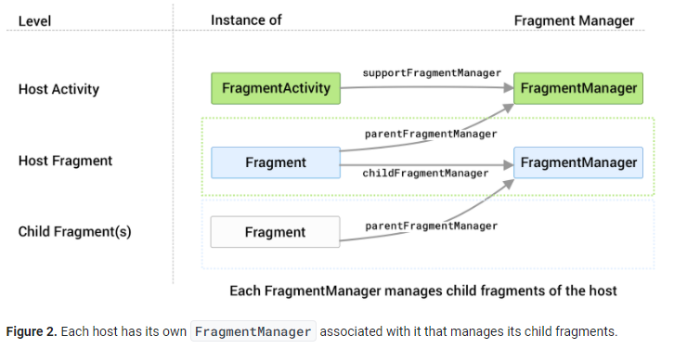
Each host has its own FragmentManager

Slide 21
Sample code to handle the fragmentManagers transactions
inline fun FragmentManager.inTransaction(func: FragmentTransaction.() -> Unit) {
val fragmentTransaction = beginTransaction()
fragmentTransaction.func()
fragmentTransaction.commit()
}
// create a new instance of the fragment
val fragment = NavigateFragment()
// add the fragment to the fragment container
supportFragmentManager.inTransaction { add(R.id.fragmentContainerViewMainNav, fragment) }

Slide 22
Specific Fragment Subclasses
Fragments

Slide 23
Extend the Fragment class
Extend Fragment class
public class SimpleFragment extends Fragment
Extend specific Fragment subclass:
DialogFragment: Floating dialog (examples: date and time pickers). It displays a dialog but inside a Fragment.
ListFragment: List of items managed by adapter
PreferenceFragment: Hierarchy of Preference objects (useful for Settings)

Slide 24
Subclasses of Fragment
DialogFrament: displays a floating dialog. A good alternative to using the dialog helper methods in the Activity class.
ListFragment: displays a list of items that are managed by an adapter, similar to ListActivity.
PreferenceFragmentCompat: displays a hierarchy of Preference objects as a list. This is used to create a settings screen for the application.

Slide 25
DialogFragment
DialogFragment is a specialized Fragment used when you want to display an overlay modal window within an activity that floats on top of the rest of the content.
This is typically used for displaying an alert dialog, a confirm dialog, or prompting the user for information within an overlay without having to switch to another Activity.
A DialogFragment is pretty similar to a Dialog, it is just wrapped inside a fragment.
A DialogFragment is a fragment that displays a dialog window, floating on top of its activity's window. This fragment contains a Dialog object, which it displays as appropriate based on the fragment's state. Control of the dialog (deciding when to show, hide, dismiss it) should be done through the API here, not with direct calls on the dialog.
DialogFragment is a fragment. So what can a fragment provide you while other objects can't?
It's the lifecycle callbacks.
Several built-in Diaglog types
AlertDialog
ProgressDialog
TimePickerDialog – allows a user to select a time
DatePickerDialog
https://guides.codepath.com/android/using-dialogfragment

Slide 26
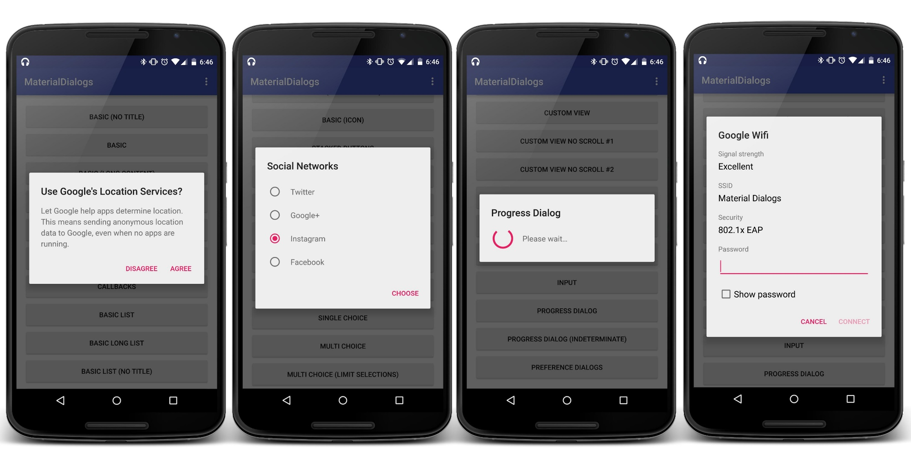
DialogFrament

Slide 27
Usage of DialogFragment
Two way to implement DialogFragment:
The onCreateView method: when the entire view of the dialog is going to be defined via custom xml
The onCreateDialog method: when you just need to construct and configure a standard Dialog class (such as AlertDialog) to display.
Import android.fragment.app, not android.app

Slide 28
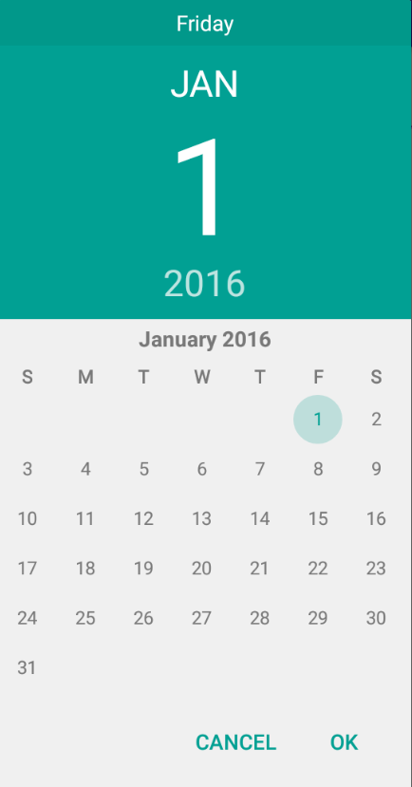
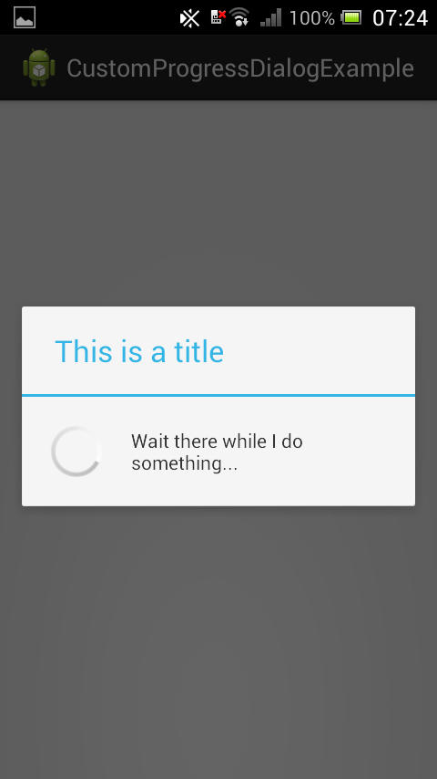
DialogFragment (continued)

Slide 29
ListFragment
A fragment that displays a list of items by binding to a data source such as an array or Cursor, and exposes event handlers when the user selects an item.
ListFragment hosts a ListView object that can be bound to different data sources, typically either an array or a Cursor holding query results. Binding, screen layout, and row layout are discussed in the following sections.

Slide 30
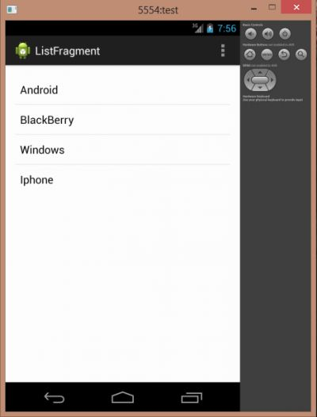
ListFragment Image

Slide 31
PreferenceFragmentCompat
In Android apps, there are often settings pages that contain different options the user can tweak. The PreferenceFragment and PreferenceFragmentCompat contains a hierarchy of preference objects displayed on screen in a list. These preferences will automatically save to SharedPreferences as the user interacts with them.
A PreferenceFragmentCompat is the entry point to using the Preference library. This Fragment displays a hierarchy of Preference objects to the user. It also handles persisting values to the device. To retrieve an instance of SharedPreferences that the preference hierarchy in this fragment will use by default, call PreferenceManager.getDefaultSharedPreferences(android.content.Context) with a context in the same package as this fragment.
Main preference types:
ListPreference: opens dialog with a list of options (see below for defining options); persists a string
EditTextPreference: opens a dialog with an EditText view for typed input; persists a string
CheckBoxPreference: uses a checkbox to persist a boolean (true when checked, false when unchecked)
SwitchPreference: uses a switch to persist a boolean (true when on, false when off)

Slide 32
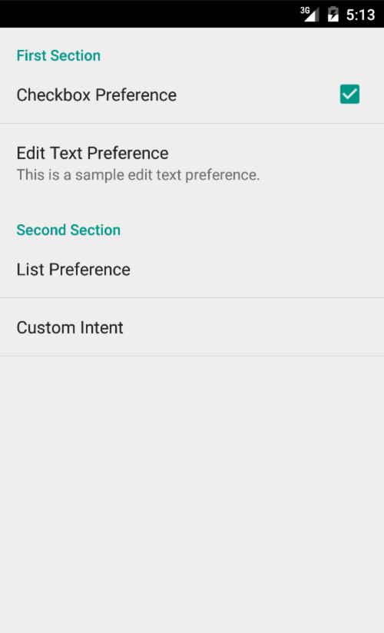
PreferenceFragmentCompat Image

Slide 33
Using Back arrows to navigate back to home
Fragments

Slide 34
Back arrow in an activity: Letting the application know the parent activity
Editing the Android Manifest file, you can specify the parent activity. This will allow for other activities to use the back arrow to return to the parent activity
android:parentActivityName=".MainActivity">
<meta-data
android:name="android.support.PARENT_ACTIVITY"
android:value=".MainActivity"/>

